Slide 1
RRDS 21: UK & European Data plumbing
19 March 2020

Slide 2
Welcome to RRDS 21
Round the table:
Firms: Allianz, BMO, BNY, Citi, Credit Suisse, DB, Goldman Sachs, LBG, Natwest Markets, Nomura, Pictet, PIMCO, Satander, RBS, Soc Gen, SEI, Stan Chart, UBS, Wells Fargo
Infrastructure: Capco, EY, LRH
Trade Associations: ISDA, EVIA
Regulators: BoE, ECB, FCA
Today ~25 people will discuss:
Top 7 updates to EU/UK regulatory data collection strategies
Group discussion of ‘end to end’ vision
Key issues, priorities and milestones
Abbreviated rules of the road:
No free rides - this does not work if you let others do all the talking​
Silence = agreement​
Chatham House Rule applies​
All attendees will receive copies of the minutes. Members will receive presentation materials​
COVID19 hygiene rules are in effect
Thank you for keeping our trusted community going on-line! ​

Slide 3
Agenda
16:00 Introductions
16:10 Recap JWG data and reporting research
16:20 Group discussion of ‘end to end’ vision
16:45 Key issues, priorities and milestones
17:00 Key take aways and next steps
17:30 End

Slide 4
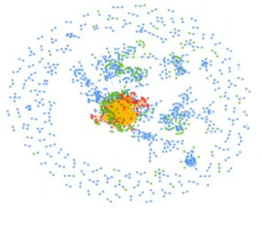
JWG 2020 research agenda
Global not for profit
Lots of reg noise and tech noise
Low awareness
Lots of siloed conversations
2019: Produced 5 white papers and ran 2 webinars
2019: Helped set the public/private sector collaborative agenda
2019: Ran 30+ global workshops with 50+ firms, vendors and regulators in a high-trust environment
Drove the global agenda for AML registry data
Helped shape the global agenda for Transparency 2.0
Operating model requirements for a patchwork of trade, eComms and voice surveillance obligations
2020 Focus
AML/ Tax: 5MLD ꟾ AML action plan ꟾ UK Economic Crime Plan ꟾ Tax
Investor Protection: PRIIPS MiFID III ꟾ Researchꟾ Product Governance/ Info ꟾ Phone recordingꟾ Semi-professionals
Transparency 2.0: Public registries ꟾ Dictionary ꟾ Standards ꟾ Single hub ꟾ MRR
Surveillance: MAD/ MAR II ꟾ Conduct ꟾ Ethics ꟾ SM&CR ꟾ ESG
Market effectiveness: MiFID III ꟾ Trading ꟾ Post trade ꟾ consolidated tape of record ꟾ data cost
Digital supply chains: Op resilience ꟾ 3rd party risk ꟾ Green Finance ꟾ Cyber ꟾ SM&CR ꟾ AI/ Data

Slide 5
2020 major regulatory reform landscape overview
Political re-alignment (e.g., post Brexit)
Market structure/ conduct
CMU: MiFID III ꟾ Trading ꟾ Post trade ꟾ consolidated tape of record ꟾ data cost
REG NMS: Market data ꟾ cost
EMIR Refit
SFTR
SRD
Prospectus
FTT
BMR
Clearing
Digital Finance
LEI
Market effectiveness
Investor Protection: PRIIPS MiFID III ꟾ Researchꟾ Product Governance/ Info ꟾ Phone recordingꟾ Semi-professionals
Surveillance: MAD/ MAR II, misconduct regimes
Surveillance
AML/ Tax: 5MLD ꟾ AML action plan ꟾ UK Economic Crime Plan ꟾ Tax
Customer & system protection
Transparency
Single Hub
Machine readable Rule books
Common Interpretation
Dictionary
Standards
Public registries
Transparency 2.0
Governance
Risk
ESG
Accountability (e.g., SMC&R)
Sustainable Investing
CRR
Climate
FRTB
LIBOR
BRRD
IFRS 9/ IFRS 17
Digital supply chains
Controls
Conduct/ Culture
AI/ Data Ethics/ Privacy
Cyber/ ICT security
3rd Party risk / Outsourcing
Op Resilience
Green Finance
TRIM / Data as capital
Accountability and automated controls

Slide 6
Reporting agenda overview
Since 2017, with support from industry SMEs from 30+ firms including we have engaged with the FCA TechSprints, BoE, European and US regulators to help shape the dialogue on the next generation of reporting
Transparency 2.0 is now upon us as:
EU regulators redefine their approach: ROFIEG report, EU €5 Billion Data strategy, Forthcoming Digital Finance strategy/ EU fitness check on reporting; and MiFID III
The UK rolls out Digital Regulatory Reporting, and kicks off a 5 year dialogue on transformation of data collection and defines post Brexit ‘equivalence’
The US CFTC and other global OTC regulators move to standardise their reporting efforts by 20203
This year we have an ambitious agenda which will include alignment to a collective path of action to get from ‘rule book’ to ‘single hub of data’ leveraging new semantic technology and AI
JWG’s RegTech RRDS provide the regulatory intelligence and collaborative, high-trust environment for SMEs to ensure they fully grasp an evolving landscape, develop their heat maps and identify solutions on a regular basis

Slide 7
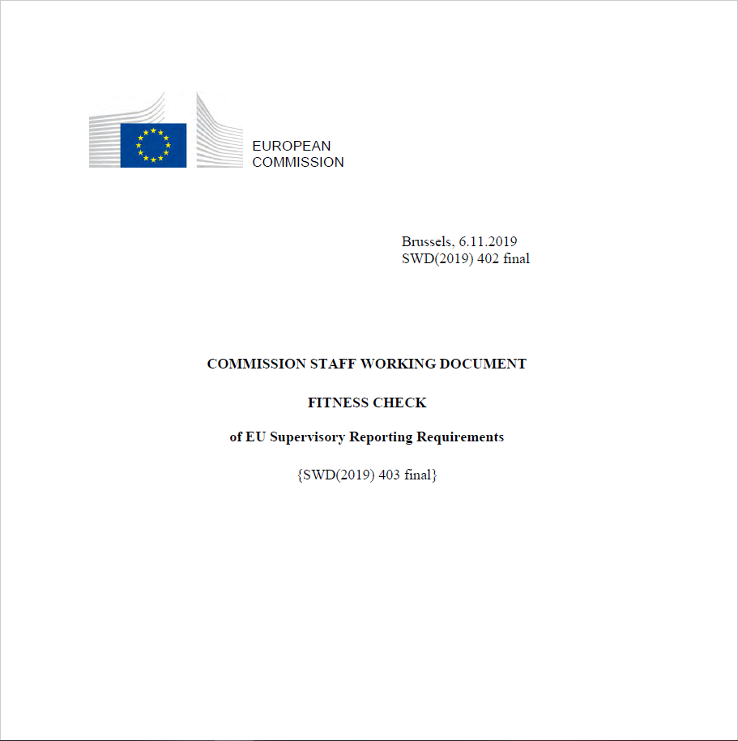
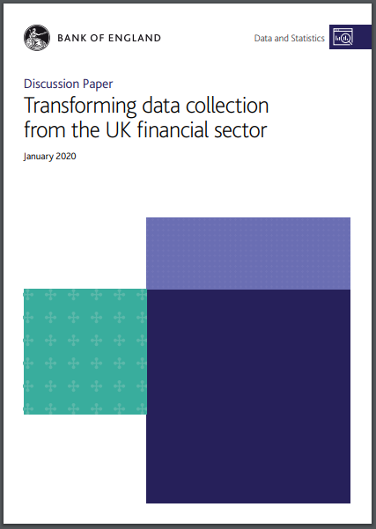
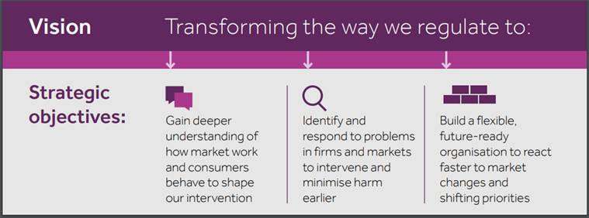
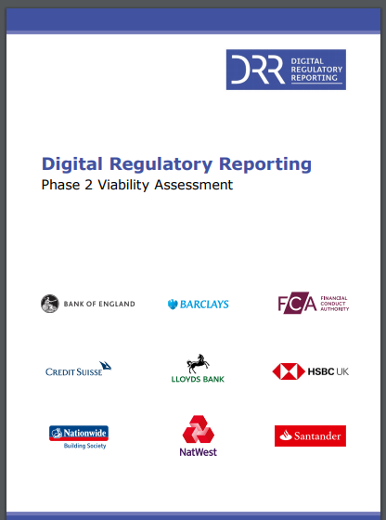
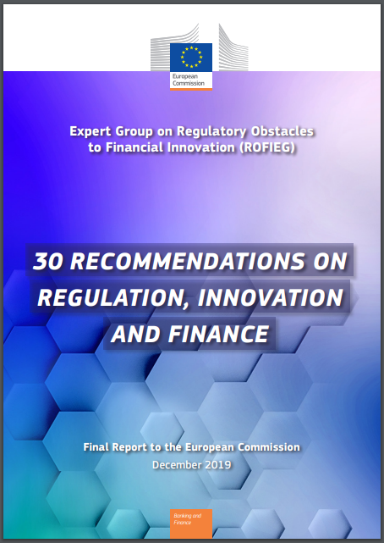
2020 Transparency 2.0
EU Fitness check on supervisory reporting requirements (11/19)
Machine Readable and Executable Reporting Requirements - Proof of Concept (PoC) Tender
BoE Data collection CP (01/20)
FCA Data strategy (01/20)
Making rules
European Data Strategy (02/20)
Legislative process and instruments
Consultation process
Stability of the requirements
Relevance of reported data
Implementation planning/timing
DRR
New model options
Common data inputs
Modernising reporting instructions
Reporting architecture and governance
Industry DRR viability assessment (01/20)
Reporting requirements
Data collection case studies
BoE/FCA/ Industry DRR
Who reports what to whom
Summary of statistics reporting requirements
Single data hub
BoE/FCA/ Industry DRR
Cost baseline
Implementation paths
Technical solutions
Reg reporting suitability
Data / API
Existing standards
Existing commercial software
New software
RoI/ scenario analysis
BoE/FCA/ Industry DRR
Root cause analysis
Benefits and costs of reporting
Effectiveness/ Efficiency
Collaboration
Data processing rules
Viable paths
Single market for data
Cross sector object connection
Standards, tools & infrastructure
‘Pro-competitive’ reporting rules
Improving market transparency
Inconsistent definitions / formats
Common dictionary/ standards
15 – Uniform regulation
Reg Reporting (Digital Finance Strategy Q320)
Semantic/ data fabric
EU Cloud
RegTech engagement
10 – Standardisation of legal terminology and classification of actors, services, products and processes
11 – Human- and machine-readable legal and regulatory language
12 – Regulatory Clearing House
25 – GDPR and new applications of technology
Capacity
Concentration risk
User rights to stay in control
2 - Firms’ internal IT governance
3 – Supervisors’ understanding of technology
9 – RegTech and SupTech
ROFIEG on reporting (12/20)

Slide 8
EU FDS / Fitness check
EU report reveals #regulatory #reporting horror and concludes that a common database of granular data and a repository of the interpretation of reporting rules in a format that is readable by computers needs to be considered. Pleased to see that #regtech would help standardise information to a better quality standard. So glad we have the #EMIR refit #DRR project moving for the #regtechcouncil
Centralised structures that will act as both a common database of reported granular data and a repository of the interpretation of reporting rules in a format that is readable by computers are currently being considered by both EU and national-level supervisors. These would remove the template-based reporting design and should help remove any gaps between the supervisors’ intents and the reporting entities' understanding
Past impact assessments did not systematically set out the objectives of reporting, or assessed its impacts…there is a case for better coordination throughout all stages of the legislative process when developing EU-level supervisory reporting requirements (particularly Level 1) to improve coherence across legislation.
There is scope to improve the consultation process. Given the technical nature of reporting, input from the ESAs is needed consistently from the early stages and throughout the process of designing the requirements. Moreover, during the consultation process, there has not always been enough time for in-depth involvement of industry during the development of Level 2 legislation and technical standards.

Slide 9
ROFIEG: 30 recommendations
Recommendation 9 - The Commission, in cooperation with the ESAs, and in co-ordination with relevant authorities and international standard setters, should develop and implement a comprehensive and ambitious agenda to revise the current inefficient reporting framework and introduce machine readable and executable legislation to enable ‘straight through processing’ of returns which are linked to regulation and compliance processes
Recommendation 10 – The Commission, in co-operation with the ESAs and the ESCB, should facilitate initiatives that promote standardisation of legal terminology and digital standards-based common classifications of actors, services, products and processes in the financial sector for use by market participants, regulators, supervisors and standard setters.
Recommendation 11 - The Commission, in co-operation with the ESAs, should adopt a strategy on how reporting and compliance processes may become both machine- and human-readable. Legal, regulatory and business vocabularies will need to be harmonised and digitised using common technical standards. This will require collaboration between EU authorities and national competent authorities working with financial institutions to develop a common financial dictionary/language and reporting requirements, on the basis of common taxonomies, vocabularies and ontologies.
Recommendation 12 - The Commission, in co-operation with the ESAs and the ESCB, should adopt a strategy for the conception and establishment of regulatory clearing houses, i.e. arrangements capable of: centralising the automated dissemination of rules to regulated entities, receiving incident and reporting information from regulated entities, and collecting market data.

Slide 10
DG FSMA Open tenders for ESMA support due 15 April
Machine Readable and Executable Reporting Requirements - Proof of Concept (PoC) Tender
Select an existing data model or extend or design a new data model rich enough to cover the transactions and life-cycle events covered by the reporting requirements.
Select an existing machine interpretable language (DAML, Rosetta...) or extend or design a machine interpretable language to express the relevant reporting requirements in a technology agnostic way
Express the reporting requirements from EMIR Refit using the language from task 2 and the data model resulting from task 1 in a machine readable and executable form and in a way that facilitates human readability, maintainability and verification
Develop a testing environment where reporting entities and the Contracting Authority could upload data expressed in the data model from task 1 and test MRER on this data to produce reports compliant with the supervisory data models and formats, and validate and inspect these supervisory reports
A group of at least five representative reporting entities (financial companies, nonfinancial companies, central counterparties and trade repositories) will be selected by the Contracting Authority to test the testing environment.
Document the complete end-to-end workflow to understand the requirements from the different stakeholders (legislators, supervisors, industry participants, etc.).
Propose an optimal architecture for a MRER solution that could be used in production by all stakeholders
Develop a machine readable and executable reporting PoC based on the EMIR Refit transaction reporting ITS/RTS as an illustration;
Assess whether MRER can lead to a more effective and efficient development of reporting requirements and consecutive steps (guidance and message formats);
Assess whether MRER can contribute to more efficient supervisory reporting and reduce the reporting burden for reporting entities;
Identify regulatory obstacles to the use of MRER technology-enabled innovation in the financial sector.

Slide 11
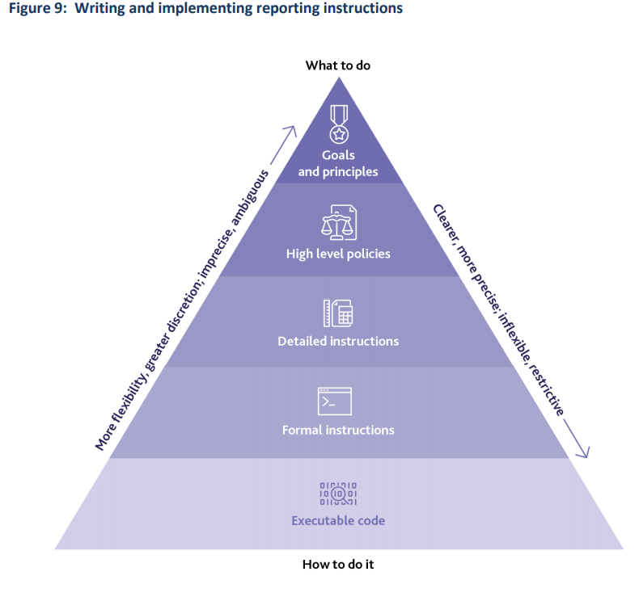
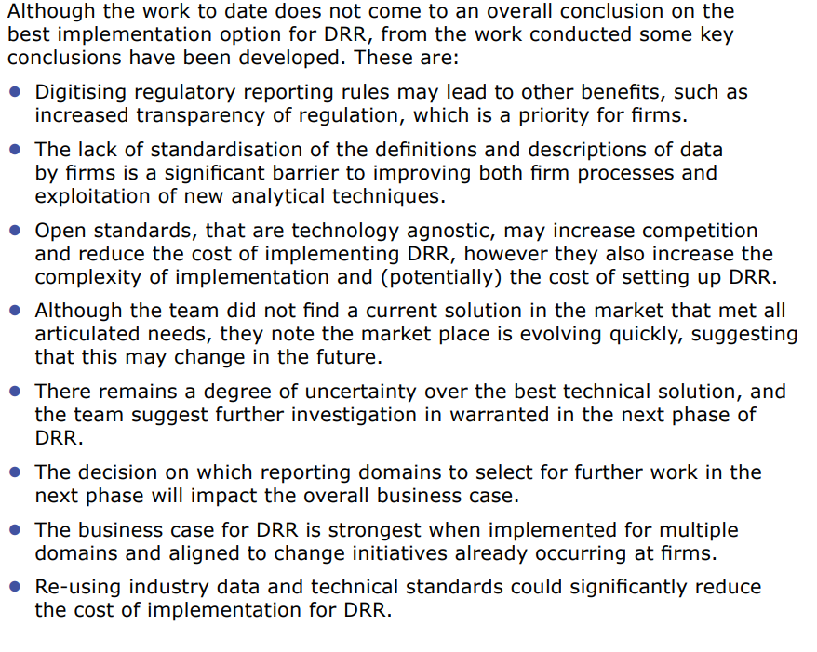
An aligned DRR vision?
FCA, the Bank of England and seven regulated firms have jointly published a Viability Assessment report on the latest Digital Regulatory Reporting (DRR) pilot

Slide 12
Refreshed FCA data strategy
The FCA’s refreshed Data Strategy sets out a transformation plan to become a highly data-driven regulator.
Deepen our understanding of markets and consumers
Swiftly identify, connect and react to firm and market issues
We will have the ability to simulate policy outcomes using automation and analysis to improve the way we regulate.
We improve our regulatory activities by using advanced data analysis techniques to identify where we need to intervene.
We will publish FCA data to allow firms to simulate and test new products and business models.
We will improve our active scanning of regulated firms and market infrastructure.
We will be able to use predictive models of harm, supporting the efficient allocation of our resources and effort
We will carry out better monitoring of harm, improving our analysis and data sources to detect and prevent misconduct.
Our Digital Regulatory Reporting allows firms to automatically supply data, reducing the cost of collection and improving data quality. Reducing the burden of data supply in the industry.
Our use of data analytics will proactively identify harm in the market, and we will use automation to act more quickly.
We will automate repeatable manual processes

Slide 13
Agenda
16:00 Introductions
16:10 Recap JWG data and reporting research
16:30 ‘end to end’ vision polling
16:45 Key issues, priorities and milestones
17:00 Key take aways and next steps
17:30 End

Slide 14
Polling and discussion framework
Transparency
Recession countermeasures?
Transparency 2.0 vision reset?
Write the rules right
Get the data correct
Dictionary
Machine readable Rule books
Common Interpretation
Standards
Public registries
Single Hub
Express reporting requirements
Input/ Output layer
Data processing strategy
Legislative process and instruments
Inconsistent definitions / formats
Common dictionary/ standards
Implementation planning/timing
Data model
Operational standards
Code
CPMI/ IOSCO OTC message standards
Who reports what to whom
Summary of statistics reporting requirements
Single data hub
CMU: MiFID III ꟾ Trading ꟾ Post trade ꟾ consolidated tape of record ꟾ data cost
Post Brexit UK: New reporting plumbing infrastructure
LEI Strategy
CPMI/IOSCO OTC Standards
EU data strategy: Digital Finance:
Establish semantic references
Interpretation
Cloud Strategy
Standardisation of legal terminology and classification of actors, services, products and processes
Human- and machine-readable legal and regulatory language
Regulatory Clearing House
‘Pro-competitive’ reporting rules
Improving market transparency
Concentration risk
User rights to stay in control
Firms’ internal IT governance
FCA/ BoE DRR
Machine Readable and Executable Reporting Requirements - Proof of Concept (PoC) for EMIR Art. 9
EMIR Art. 9 DRR project: Test scenarios, report output, reporting logic on the cross-industry association CDM

Slide 15
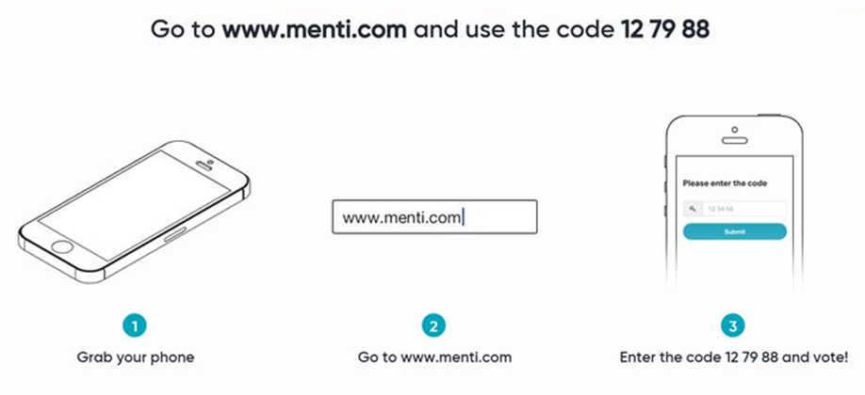
Polling questions

Slide 16
Voting questions
Would you consider EU and UK reporting strategies to be equivalent?
No: Europe is moving far further ahead and faster based on what we can see
Maybe: It’s hard to reconcile UK high-level ‘big picture’ simplification messaging with a detailed data collection drive
Yes: The UK vision is more comprehensive than Europe’s – we just can’t see it yet
Does the ‘end to end’ vision of ‘write the rules right’ + ‘get the data right’ make sense?
Yes: It’s the only way forwards
Maybe: I think so, but have doubts
No: it will never work, we should just back away
Which of the following policy drivers is most likely to drive that reset furthest and fastest?
CMU/ MiFID III
Post Brexit UK data plumbing upgrades
CPMI/ IOSCO ISO 20022 standard OTC reporting message
LEI ROC strategic reset/ LEI legislation
Recession countermeasures
Do you think a ‘Transparency 2.0’ strategic reset is required?
No: LEI Roc efforts to standardize OTC reporting are enough
Yes: CPMI/IOSCO is just a starting point
Maybe: Wait for existing policy drivers to sort themselves out before tackling this question
When should the RegTech Council align the industry with EC/ESMA and FCA/BoE data collection efforts?
Now: A common bridge across the channel is critical and we need to be moving NOW to be ready for EMIR Article 9
Never: Can’t get the support internally until regulators mandate collaboration – try again in 2021/ post SFTR....
Later this year: If the trade associations push for this to happen with my top management, it might happen – but probably in summer

Slide 17
Agenda
16:00 Introductions
16:10 Recap JWG data and reporting research
16:20 Group discussion of ‘end to end’ vision
16:45 Key issues, priorities and milestones
17:00 Key take aways and next steps
17:30 End

Slide 18
RRDS Agenda 2020
Month | Meeting Topic | Agenda | Host
9 Jan | RRDS 20: EMIR Refit – DRR + European Data strategy | Key updates to EU/UK regulatory data collection strategies​ A plan for the RegTech Council EMIR Refit interpretation project​ Next steps for the RTC and RRDS in 2020​ | Goldman Sachs
7 Feb | Changing the reporting framework with RegTech | Deploying new reporting tech assets Moving to newly-agreed standards Scaling approaches from lab to shop floor The promise of collaboration, standards and common reference data | Tower Gourman
19 Mar | RRDS 21: EU and UK regulatory data plumbing plans | Key updates to EU/UK regulatory data collection strategies Group discussion of ‘end to end’ vision Key issues, priorities and milestones | Online
7 May | RRDS 22: Gaps and interdependencies between regulatory data efforts | Recap on priority issues and action items Transparency 2.0 target state articulation Engagement approach with interdependent regulatory agendas | Online
July | RRDS 23: MiFID III transparency and the data agenda | New investment report with 109 data fields for 3rd country firms MiFID III consultation | TBC
ESG, Brexit, MAR II, MiFID III and other big reg agendas
SM&CR and accountability
Implementation barriers

Slide 19
ESMA will consider the responses it receives to this consultation paper in Q2 2020 and expects to publish the draft technical standards and send the final report to the European Commission for endorsement in Q3 2020.
Contact details of the third-country firm, including the person in charge of submitting the information
Investment services, activities and ancillary services provided by the branch in the Member State where the branch is established
Investment services, activities and ancillary services provided by the branch in Member States other than the one where it is established
Number of clients and counterparties of the branch in the Member State where the branch is established
Number of clients and counterparties of the branch in Member States other than the one where the branch is established and globally
Turnover of the branch in the Member State where the branch is established
Turnover of the branch in Member States other than the one where the branch is established and of the third-country firm globally
Where the branch performs activity (3) of Section A of Annex I to Directive 2014/65/EU, information on the exposure of the third-country firm to counterparties in the Union
Where the branch performs activity (3) of Section A of Annex I to Directive 2014/65/EU, information about the value of the assets under management for clients in the Union
Where the branch provides service (5) of Section A of Annex I to Directive 2014/65/EU, information about the value of the assets under advice for clients in the Union
Where the branch provides ancillary service (1) of Section A of Annex I to Directive 2014/65/EU or is holding client funds, information on the value of the assets (including cash) held by the branch in the Union
Composition of the management body of the third-country firm
Persons who effectively direct the business of the firm
Key function holders for the activities of the branch
Information about complaints received by the branch or by the third-country firm in relation to the activities of the branch in the Union
Description of the marketing activities of the branch or of the third-country firm in relation to the activities of the branch in the Union
Description of the investor protection arrangements of the third-country firm and applicable to the operations of the branch in the Union, including the rights of those clients resulting from the investorcompensation scheme referred to in Article 39(2)(f) of Directive 2014/65/EU (to be provided as an update covering any material changes compared to last information provided in this respect)
Information on the outsourcing arrangements of the third-country firm and applicable to the operations of the branch in the Union (to be provided as an update covering any material changes compared to last information provided in this respect)
Information on the arrangements (including IT arrangements) set up by the thirdcountry firm and applicable to the activities of the branch for algorithmic trading, for high frequency trading (HFT) and for direct electronic access (DEA)
Information on the activities of the compliance function (or equivalent)
Information on the activities of the internal audit function (or equivalent)
Information on the activities of the risk management function (or equivalent) and the risk management policy of the thirdcountry firm
Any other information considered by the competent authority necessary to enable comprehensive monitoring of the activities of the branch in the Union

Slide 20
Moving forward in 2020 with JWG and the RTC
JWG RegTech SIGs provide a collaborative, high-trust environment for SMEs from the sell-side, buy-side and vendors to identify key challenges and identify solutions on a regular basis.
The RegTech Council is a global not for profit public-private forum focused on changing the way FS regulations are developed, implemented and monitored. All market ecosystem participants work together to create value by leveraging new technology to make compliance more effective and efficient
Investigation and analysis
Global regulatory reporting dialogue management
Membership crowdsourcing
Top insight from the public and private sector
Quality intelligence
Global not for profit
Flagging new initiatives
Examining individual regulatory implementation efforts
Collaboration
Being in a safe space to explore the ‘art of the possible’
Safe space
An independent forum for members to share ideas freely
Heat map
Tracking issues and priorities
Project execution
Research and development to enhance industry practice
Consensus
Developing common opinion and providing consultation response input to regulators
Reusable IP
Enables open source sharing of artefacts across the industry

Slide 21
Next SIG agendas
To participate in any of JWG’s RegTech special interest groups or for more information about the RegTech council, please email Corrina on Corrina.stokes@jwg-it.eu
Upcoming dates for your calendars:
European and UK regulatory data plumbing plans
19 March
AML data opportunities & the ICO PET consultation May
SM&CR & surveillance
12 March
RTC EMIR Refit DRR
April
Opportunities to get KYC registries right July
AI governance, Culture & surveillance
23 April
RTC AML registry data programme deliverables
April
Gaps and interdependencies between regulatory data efforts
7 May

Slide 22
Thank you
www.regtechfs.com
www.jwg-it.eu/collaboration
www.RegDelta.com
Intelligence
Collaboration
Actionable insight
Call us:
+44 20 7870 8004
info@jwg-it.eu
www.jwg-it.eu
@jwg_group
/jwg-group-ltd

